Slide 1

KALERWE
S.D.A Hymnal 566
4 ~ Verses
102.
Yesu Ali Ku Luggi.…
~
There`s a Stranger at the Door…

Slide 2
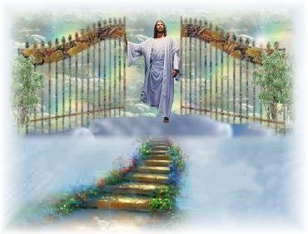
1 of 4 verses
Yesu ali ku luggi,
ggulawo
Akulindiridde nnyo,
ggulawo
Muyingize tagenda,
Ye mutukuvu Yesu,
Omwana wa Katonda,
Ggulawo.

Slide 3
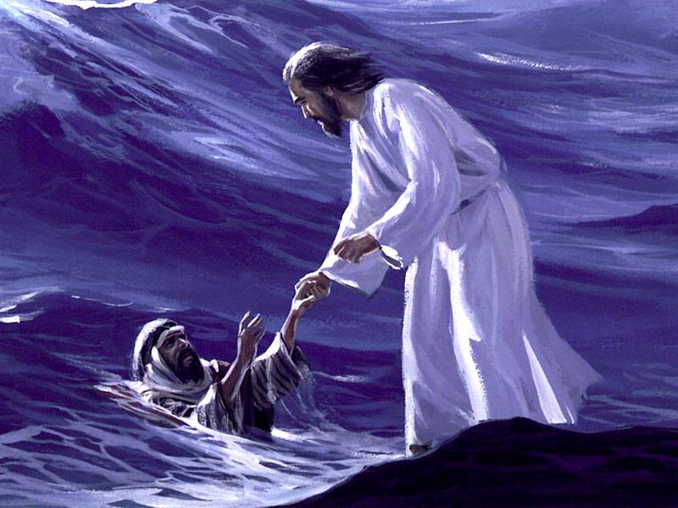
2 of 4 verses
Wulira akuyita,
wulira
Londa ye va ku by`ensi,
wulira
Ali awo ku luggi
Anakuwa essanyu
Olw`erinya ly(e) egganzi,
wulira.

Slide 4
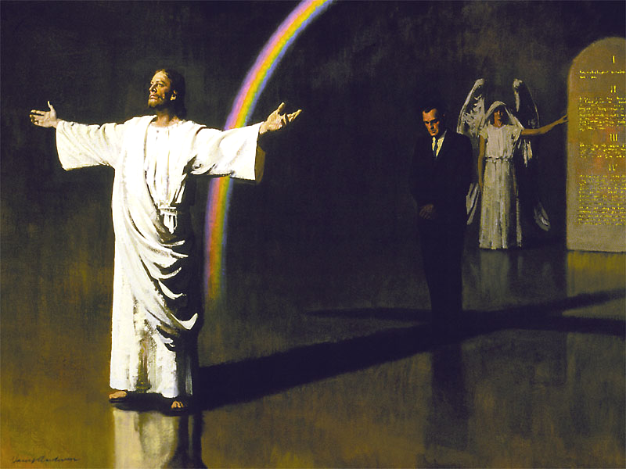
3 of 4 verses
Ggulawo (o)mutima gwo,
Ggulawo...
Bw`onolwa (a)nakuvaako,
Ggulawo…
Ye mukwano gwo ddala.
(O)mutima gw(o) agutaasa,
So takwabulirenga,
Ggulawo…

Slide 5
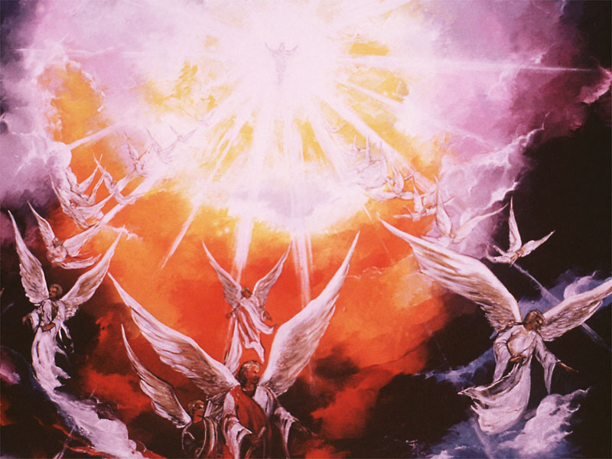
4 of 4 verses
Yesu ava mu Ggulu,
Ggulawo...
Alye awamu naawe Ggulawo…
Alyok(e) akulokole,
Kkiriz(a) okwagala kwe,
Akutwale mu ggulu.
Ggulawo…

